Slide 1

Expense Tracker Project
A Python Menu-Driven Program

Slide 2
Features:
Add new expenses
View all expenses
Calculate total spending
Exit program
Introduction
Purpose: Track daily expenses

Slide 3
Tools & Concepts Used
Programming Language: Python
Concepts:
Concepts:
Lists (expence[])
Dictionaries (to store expense details)
Loops (while True)
Conditional statements (if-elif-else)
User input handling

Slide 4
Data Storage
Expenses stored in a list of dictionaries
Each expense has:
Date
Category
Description
Amount

Slide 5
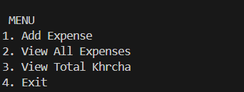
Features
Add new expense
View all expenses
Calculate total spending
Exit program

Slide 6
Adding Expense
User inputs details:
  Date
  Category (FOOD, TRAVEL, MAKEUP, BOOKS)
  Description
  Amount
Expense dictionary appended to list

Slide 7
Viewing Expenses
If list is empty → "No expenses recorded yet."
Otherwise → Iterates through list and prints details

Slide 8

Total Expense
Uses sum() with list comprehension:
Displays total expense

Slide 9
Exit
Option 4 ends the loop
Prints goodbye message

Slide 10
Thankyou

